Slide 1
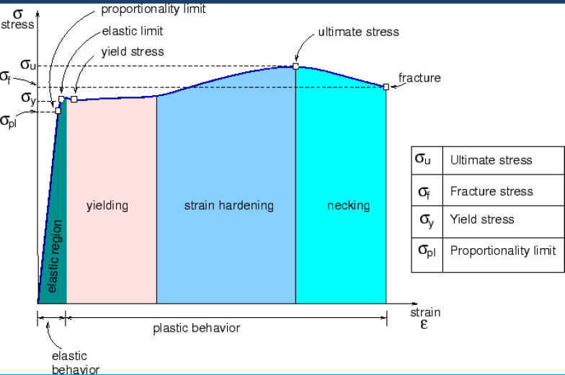
Dr. Suha K. Shihab
Stress / strain graph

Slide 2
LINEAR ELASTIC PROPERTIES
Dr. Suha K. Shihab
• Modulus of Elasticity, E (also known as Young's modulus): the ratio of stress to strain within the linear (elastic) region of the stress-strain curve
• Hooke's Law:
E =σ / ε
Young’s Modulus
A measure of the “stiffness” of a material
• Also known as the Modulus of Elasticity
• Units are the same as the units of stress (F/A), Units: E: [GPa] or [psi]
Range of E in materials is enormous:
E(metal) 45-400 Gpa
E(Ceramics) 60-500 GPa
E(Polymers) 0.01-4 GPa

Slide 3
OTHER ELASTIC PROPERTIES
Dr. Suha K. Shihab
• Elastic Shear modulus, G:
simple
torsion
test
G= τ/γ
τ = shear stress
γ = shear strain
• Elastic Bulk modulus, K:
K= -PΔV /V
P =pressure,
V = Volume
ΔV / V= Bulk strain
pressure
test: Init.
vol =V_{o}.
Vol chg.
= ΔV
• Special relations for isotropic materials:

Slide 4
PLASTIC (PERMANENT) DEFORMATION
Dr. Suha K. Shihab
(at lower temperatures, T < T_{melt}/3)
• Simple tension test:
•PLASTIC DEFORMATION is a permanent deformation (usually considered for T<Tm/3). Atoms break bonds and form new ones. In metals, plastic deformation occurs typically at strain ≥0.005.

Slide 5
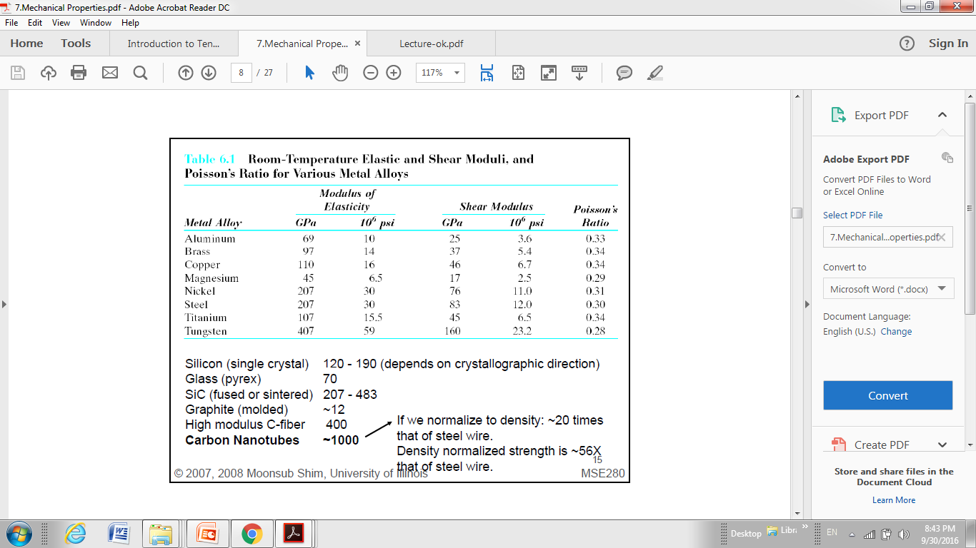
Dr. Suha K. Shihab

Slide 6
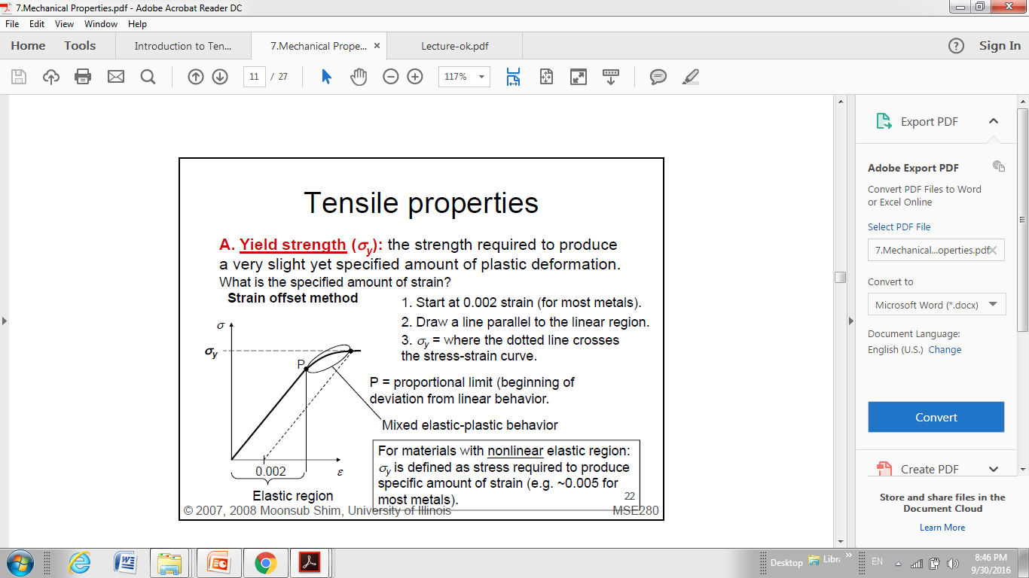
Dr. Suha K. Shihab

Slide 7
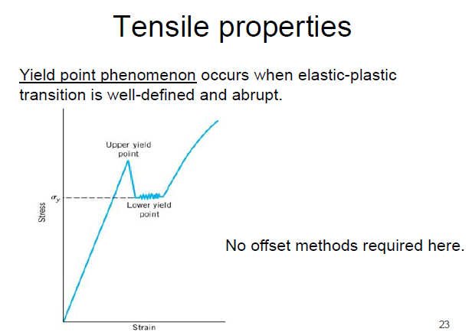
Dr. Suha K. Shihab

Slide 8
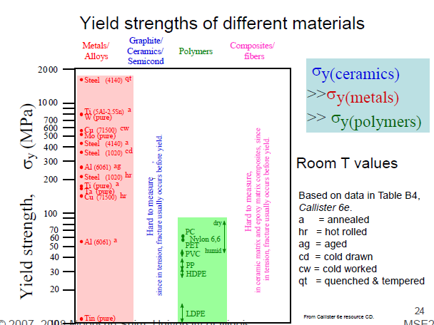
Dr. Suha K. Shihab

Slide 9
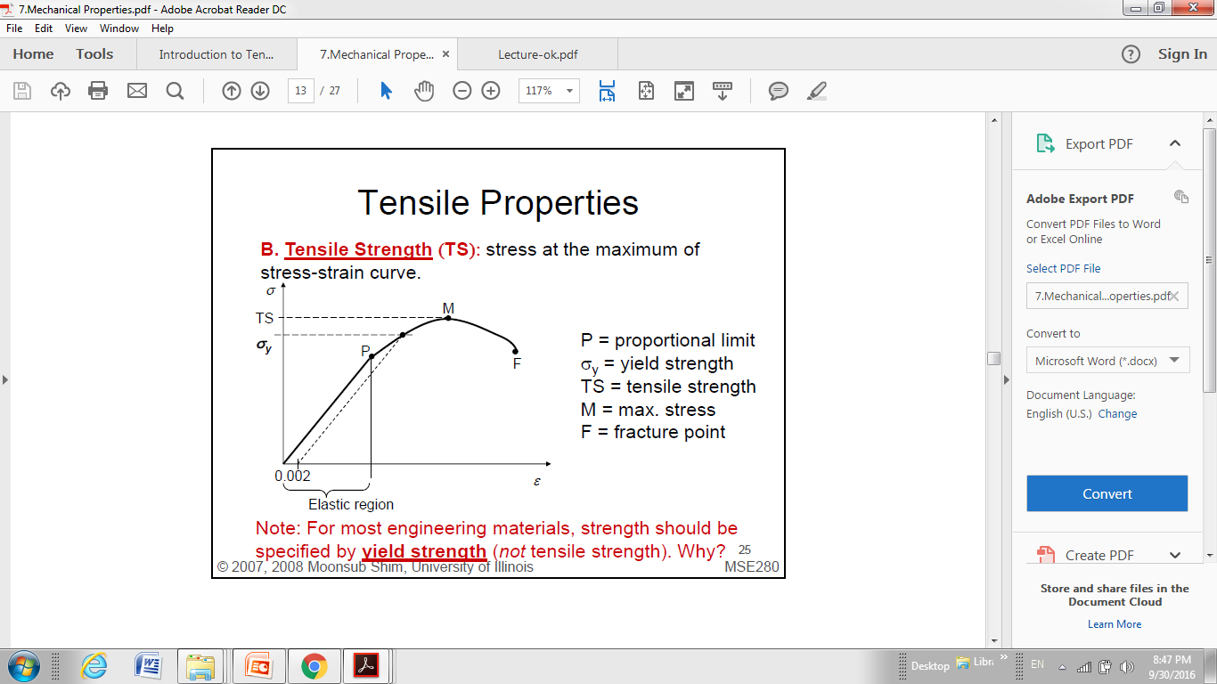
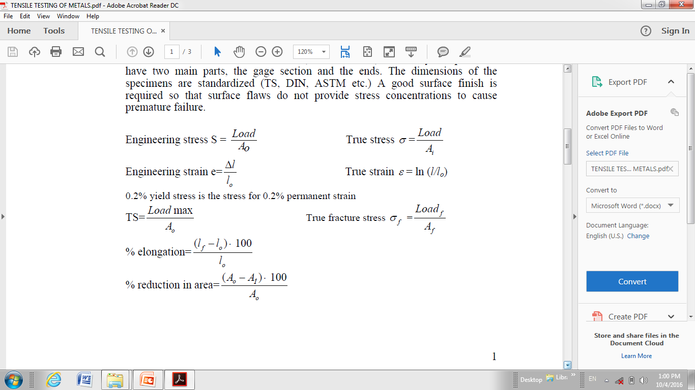
Dr. Suha K. Shihab
Ultimate stress = Tensile Strength= TS=UTS=σ_{UTS}
Note: For most engineering materials, strength should be specified by yield strength (not tensile strength). Why?

Slide 10
TENSILE STRENGTH: COMPARISON
Dr. Suha K. Shihab
Room T values
Based on data in Table B4,
Callister 6e.
a = annealed
hr = hot rolled
ag = aged
cd = cold drawn
cw = cold worked
qt = quenched & tempered
AFRE, GFRE, & CFRE =
aramid, glass, & carbon
fiber-reinforced epoxy
composites, with 60 vol%
fibers.
19

Slide 11
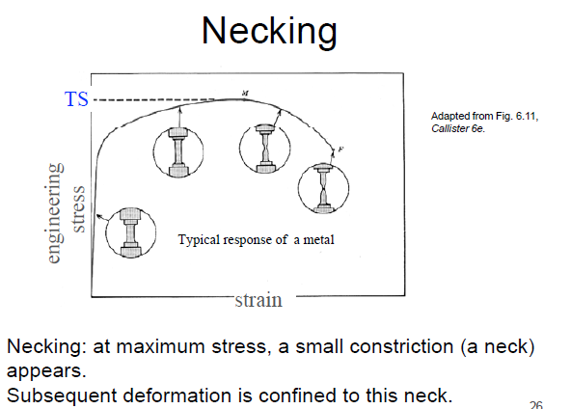
Dr. Suha K. Shihab

Slide 12
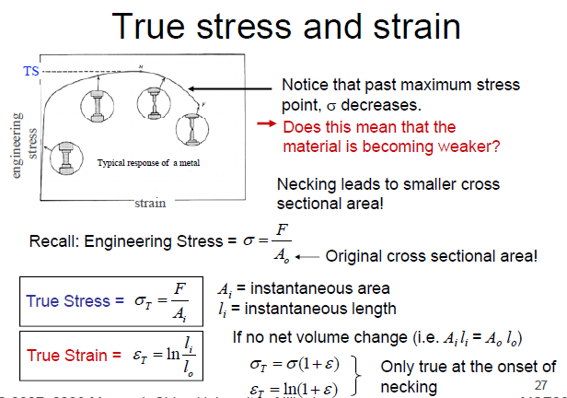
Dr. Suha K. Shihab

Slide 13
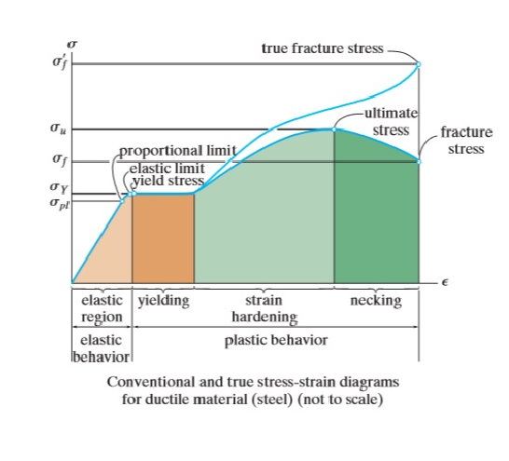
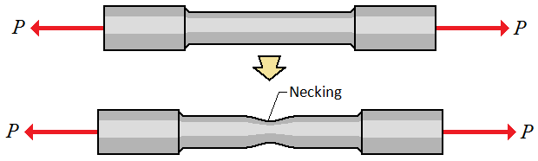
Dr. Suha K. Shihab
The result of the applied force and the actual cross area at the moment of applying force on that area is called true stress.
Where as, the applied force divided by the initial cross section area is called as engineering stress.

Slide 14
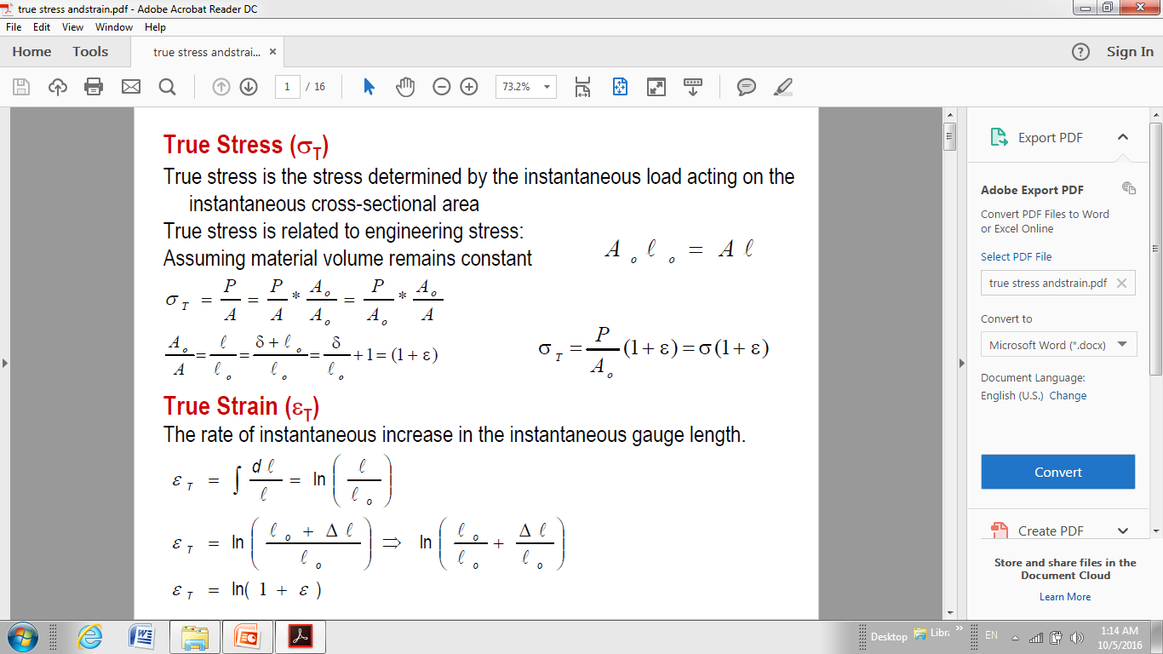
Dr. Suha K. Shihab

Slide 15
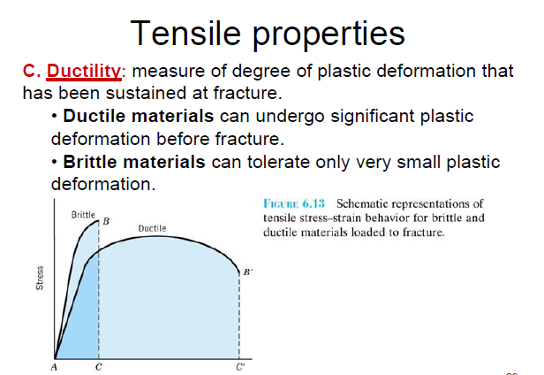
Dr. Suha K. Shihab

Slide 16
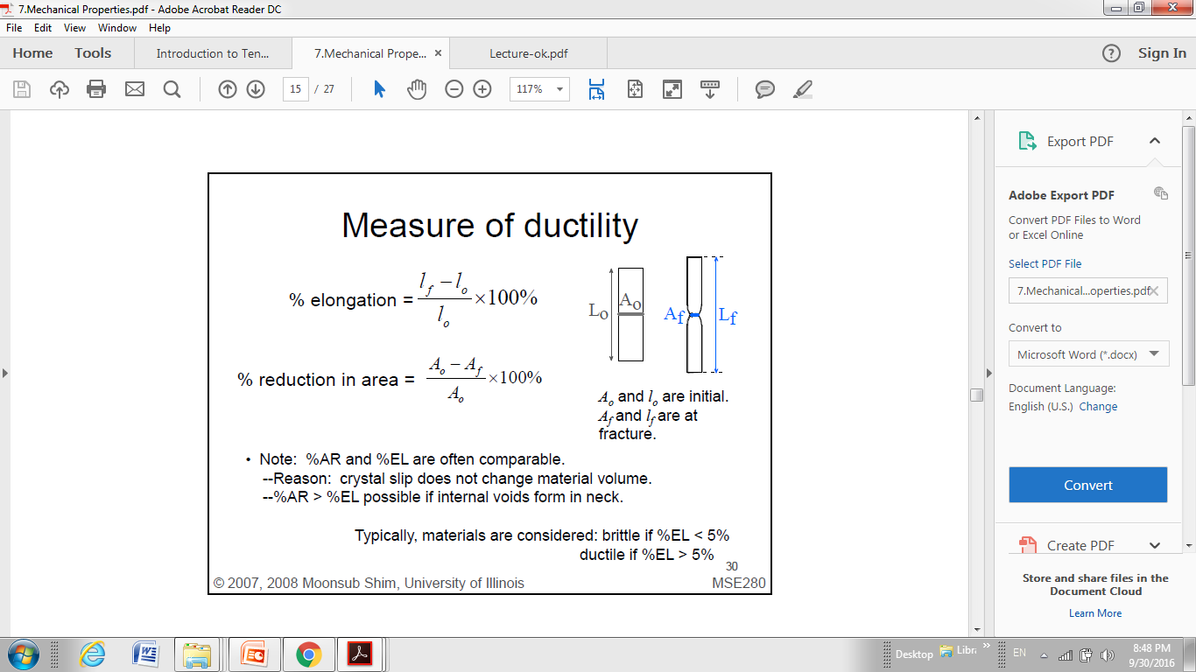
Dr. Suha K. Shihab
Percent Reduction of Area : reduction in area at fracture in necking region with respect to original cross-section area; this is a measure of the ductility of the material.

Slide 17
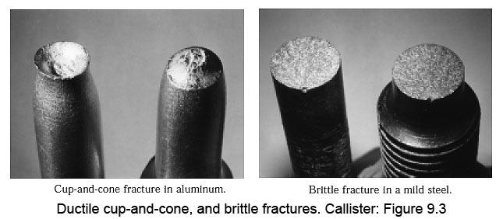
Dr. Suha K. Shihab
Ductile vs Brittle Fracture
An examination of the fracture surface of a tensile test piece can show whether the part was ductile or brittle.
Ductile specimen showing “cup-and-cone” failure, where shearing occurs at 45o to the applied force.
Brittle specimen displays an almost flat fracture surface, perpendicular to the applied force.

Slide 18
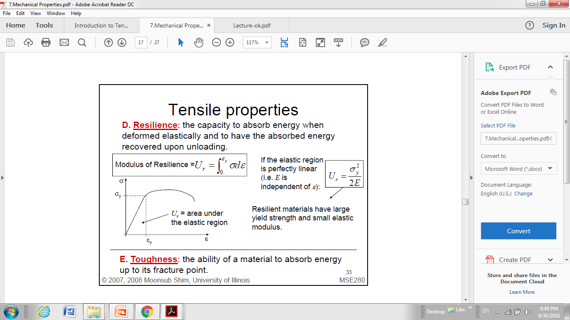
Dr. Suha K. Shihab
Modulus of resilience: the amount of energy (or work) stored per unit volume at the elastic limit.
E. Toughness: the ability of a material to absorb energy up to its fracture point.
Modulus of toughness: the amount of energy stored per unit volume at fracture of the material; this is a measure of the ductility of the material.

Slide 19
Dr. Suha K. Shihab
Strain Hardening parameter (n)
The most commonly used expression for strain hardening is the simple power law:
K = strength coefficient
n = strain hardening exponent
Work hardening, also known as strain hardening or cold working: is the strengthening of a metal by plastic deformation. This strengthening occurs because of dislocation movements and dislocation generation within the crystal structure of the material. So , Strain hardening is due to the increased resistance to dislocation movement through a crystal structure.
The value of the strain hardening exponent lies between 0 and 1. A value of 0 means that a material is a perfectly plastic solid, while a value of 1 represents a 100% elastic solid. Most metals have an n value between 0.10 and 0.50

Slide 20
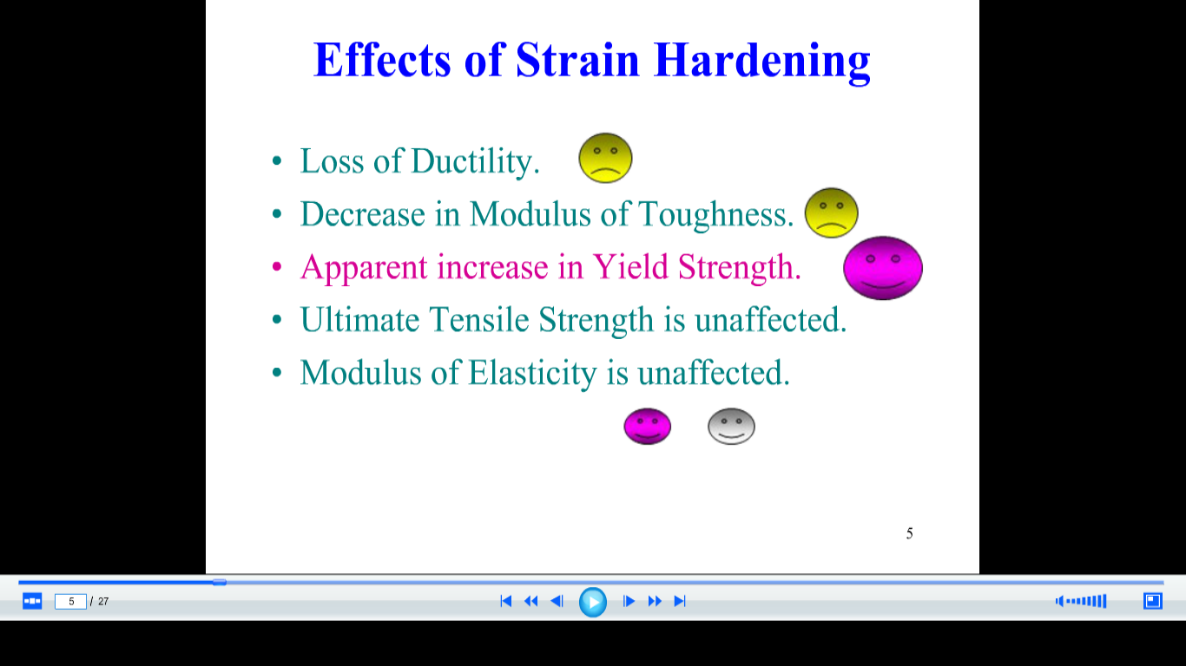
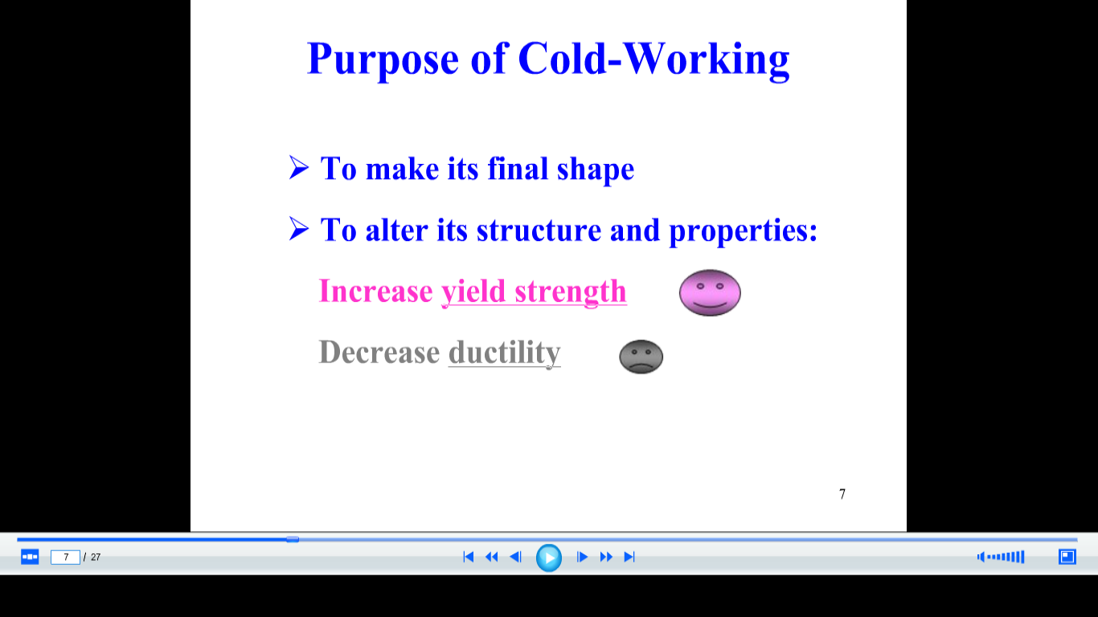
Dr. Suha K. Shihab

